Slide 1
Probability Basics
Probability Distribution
Using Distributions
Nonparametric statistics
Sampling distribution

Slide 2
Probability Refresher
Probabilities range from 0 (impossible) to 1 (certain)
Probabilities sum to 1
A distribution relates outcome x with probability p(x)
A mass function is for when you have discrete outcomes

Slide 3
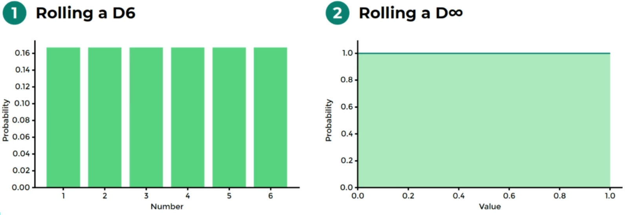
Notes:
0.2555555555555555, 0.000000000000000001 1/100000000000000000000000

Slide 4
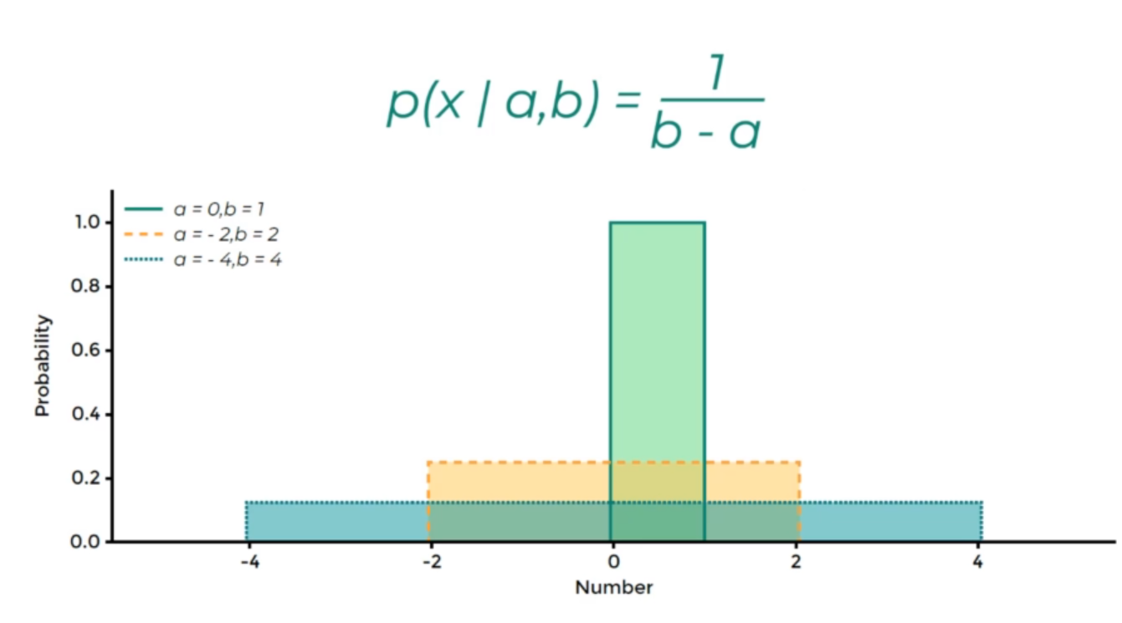
Uniform Distribution

Slide 5
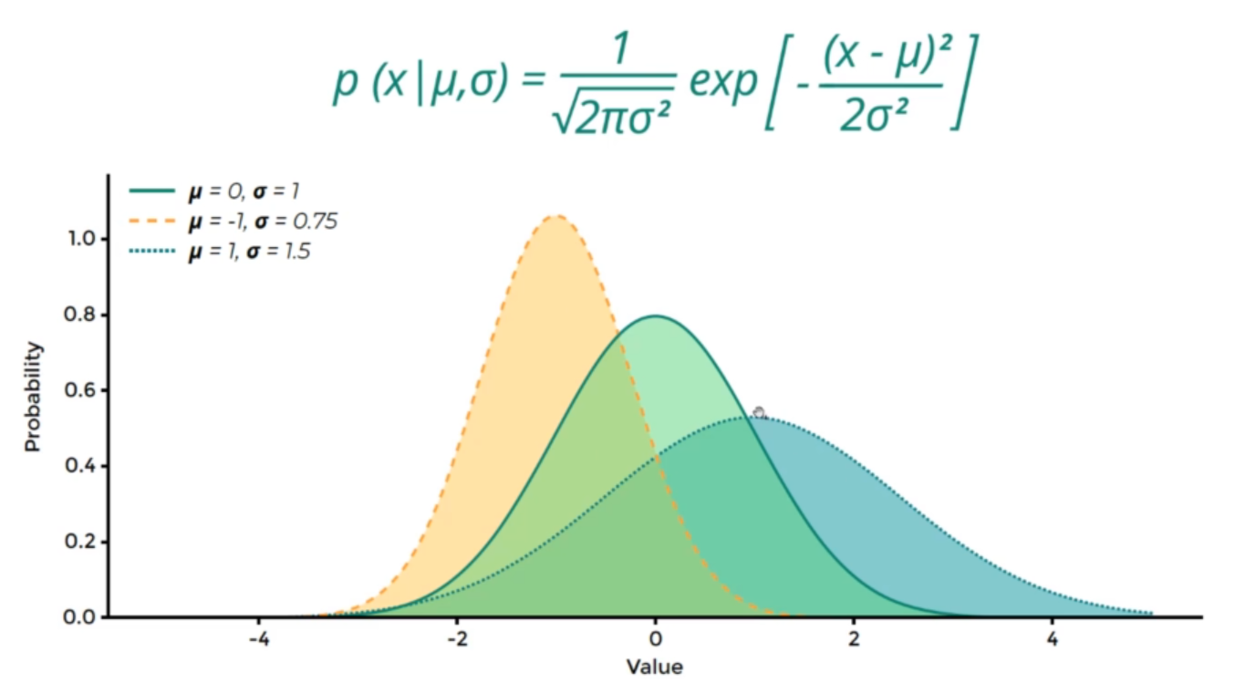
Normal Distribution
Notes:
Normal distribution, the area all the time is equal to one

Slide 6
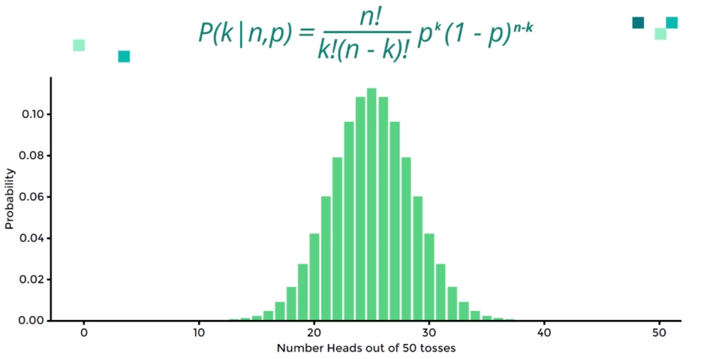
Binomial Distribution – indipendent
Notes:
Yes or no, positive or negative , head or tail….

Slide 7
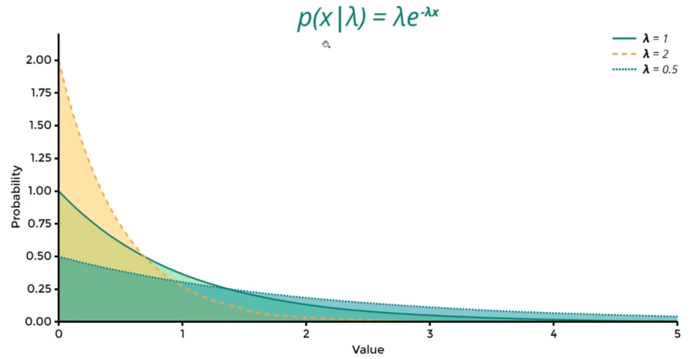
Exponential Distribution
Notes:
Product age,

Slide 8
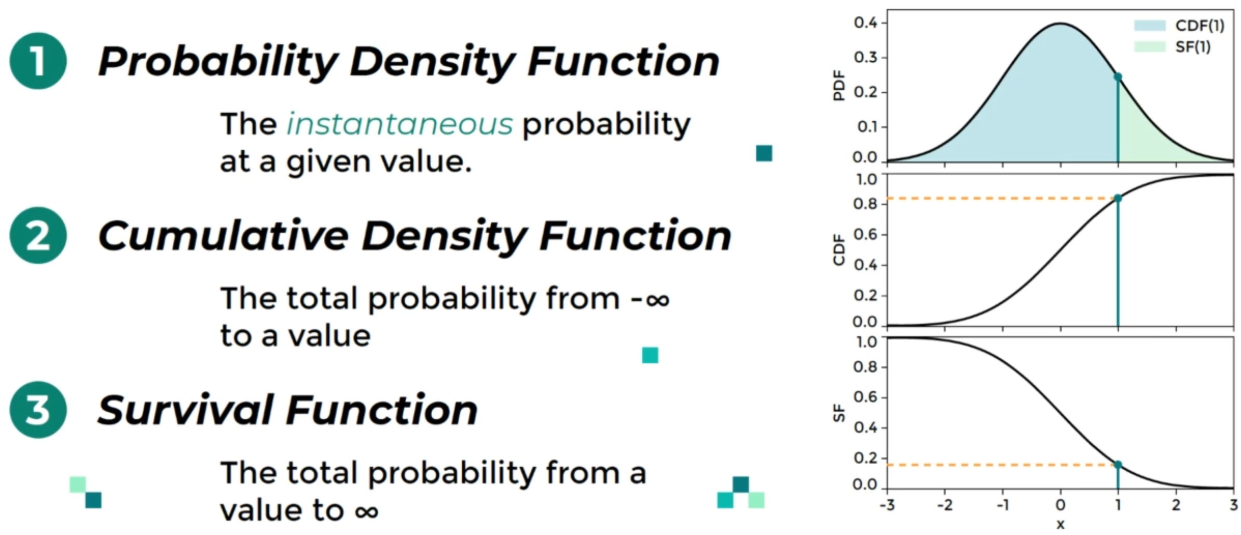
Using Distributions

Slide 9
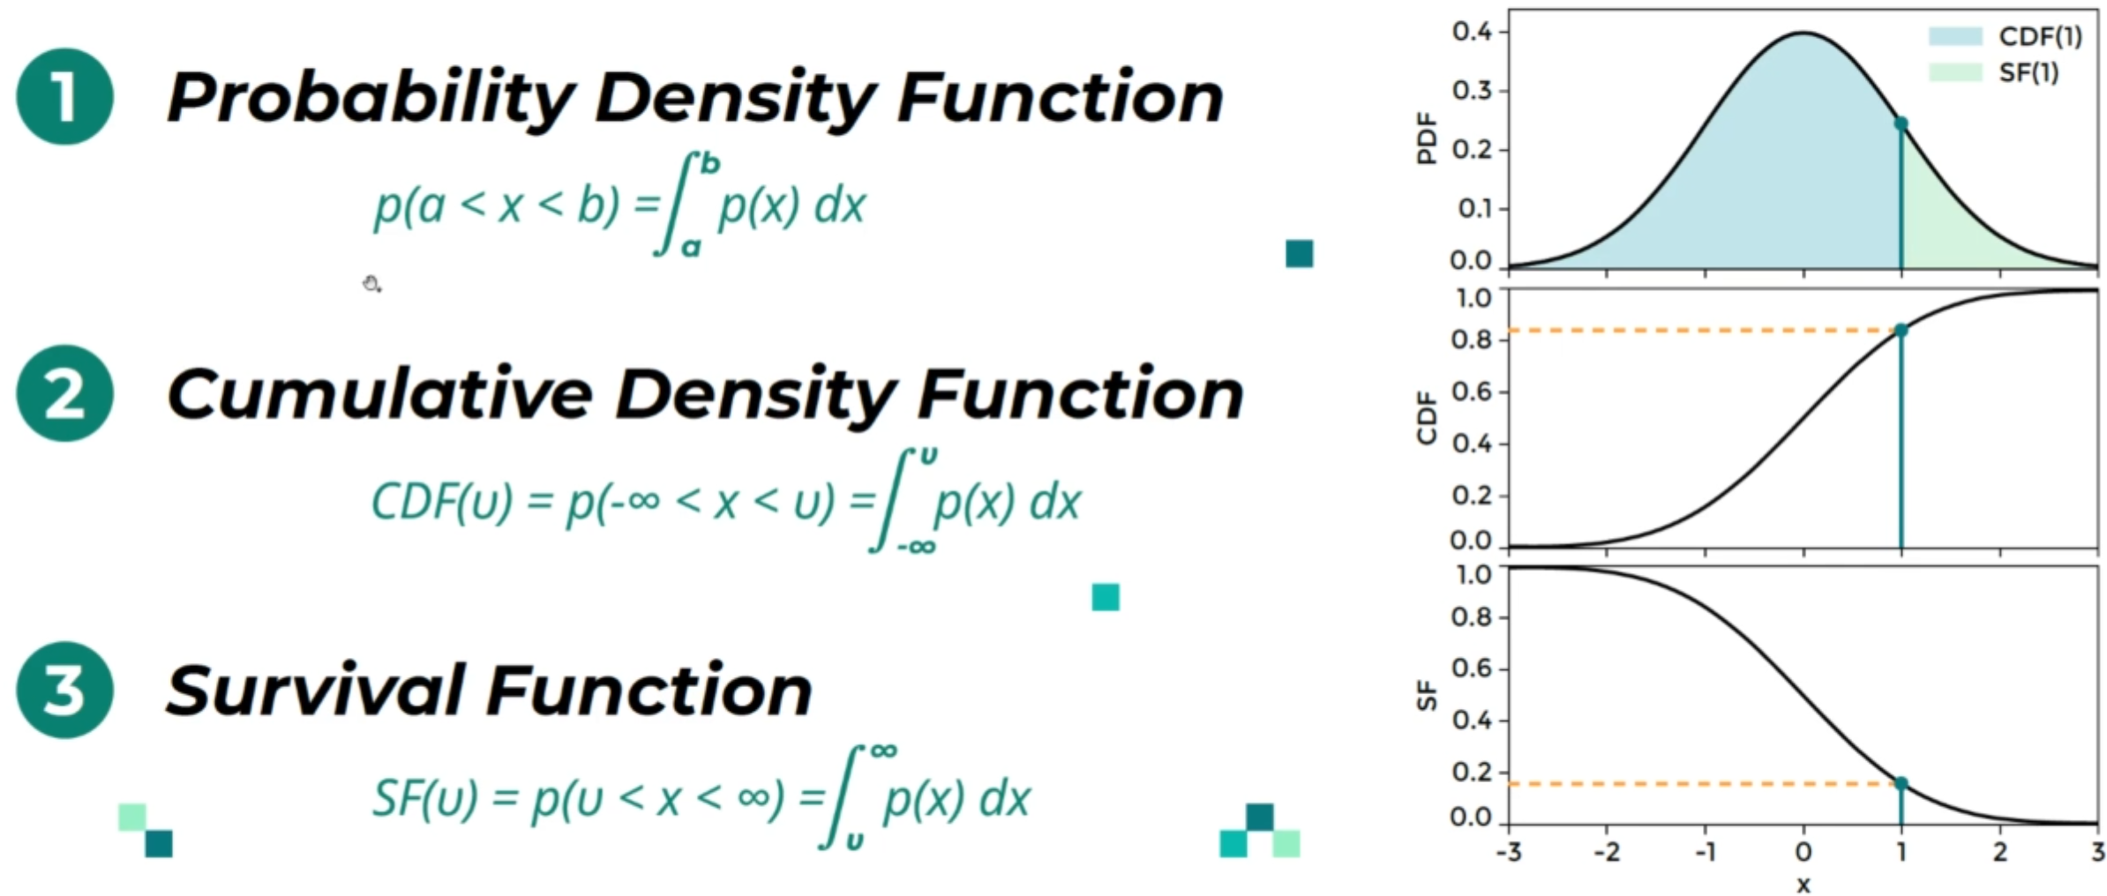
Generalisations

Slide 10
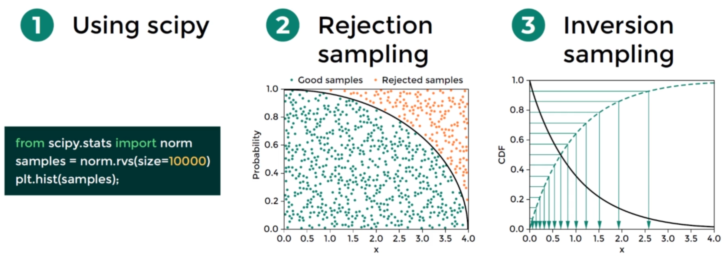
Sampling Distribution
Notes:
continuous random variable sampling

